Slide 1
Memory Hierarchy
Unit 7

Slide 2
Memory Hierarchy and its Characteristics
Why Memory Hierarchy is Required in the System?
Memory Hierarchy is one of the most required things in Computer Memory as it helps in optimizing the memory available in the computer.
There are multiple levels present in the memory, each one having a different size, different cost, etc.
Some types of memory like cache, and main memory are faster as compared to other types of memory but they are having a little less size and are also costly whereas some memory has a little higher storage value, but they are a little slower.
Accessing of data is not similar in all types of memory, some have faster access whereas some have slower access.

Slide 3
Types of Memory Hierarchy
This Memory Hierarchy Design is divided into 2 main types:
External Memory or Secondary Memory: Comprising of Magnetic Disk, Optical Disk, and Magnetic Tape i.e. peripheral storage devices which are accessible by the processor via an I/O Module.
Internal Memory or Primary Memory: Comprising of Main Memory, Cache Memory & CPU registers. This is directly accessible by the processor.

Slide 4
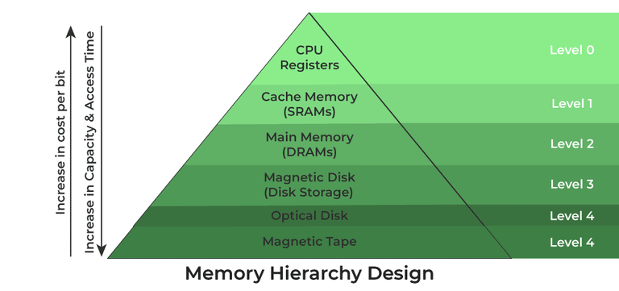
Memory Hierarchy Design
1. Registers
Registers are small, high-speed memory units located in the CPU.
They are used to store the most frequently used data and instructions.
Registers have the fastest access time and the smallest storage capacity, typically ranging from 16 to 64 bits.

Slide 5
2. Cache Memory
Cache memory is a small, fast memory unit located close to the CPU.
It stores frequently used data and instructions that have been recently accessed from the main memory.
Cache memory is designed to minimize the time it takes to access data by providing the CPU with quick access to frequently used data.
3. Main Memory
Main memory, also known as RAM (Random Access Memory), is the primary memory of a computer system.
It has a larger storage capacity than cache memory, but it is slower.
Main memory is used to store data and instructions that are currently in use by the CPU.

Slide 6
Types of Main Memory
Static RAM: Static RAM stores the binary information in flip flops and information remains valid until power is supplied.
It has a faster access time and is used in implementing cache memory.
Dynamic RAM: It stores the binary information as a charge on the capacitor.
It requires refreshing circuitry to maintain the charge on the capacitors after a few milliseconds. It contains more memory cells per unit area as compared to SRAM.

Slide 7
4.Secondary Storage.
Secondary storage, such as hard disk drives (HDD) and solid-state drives (SSD), is a non-volatile memory unit that has a larger storage capacity than main memory.
It is used to store data and instructions that are not currently in use by the CPU.
Secondary storage has the slowest access time and is typically the least expensive type of memory in the memory hierarchy.

Slide 8
5.Magnetic Disk
Magnetic Disks are simply circular plates that are fabricated with either a metal or a plastic or a magnetized material.
The Magnetic disks work at a high speed inside the computer and these are frequently used.

Slide 9
6. Magnetic Tape
Magnetic Tape is simply a magnetic recording device that is covered with a plastic film. It is generally used for the backup of data.
In the case of a magnetic tape, the access time for a computer is a little slower and therefore, it requires some amount of time for accessing the strip.

Slide 10
Characteristics of Memory Hierarchy
Capacity: It is the global volume of information the memory can store.
As we move from top to bottom in the Hierarchy, the capacity increases.
Access Time: It is the time interval between the read/write request and the availability of the data.
As we move from top to bottom in the Hierarchy, the access time increases.
Performance: Earlier when the computer system was designed without a Memory Hierarchy design, the speed gap increased between the CPU registers and Main Memory due to a large difference in access time.
This results in lower performance of the system and thus, enhancement was required. This enhancement was made in the form of Memory Hierarchy Design because of which the performance of the system increases.
One of the most significant ways to increase system performance is minimizing how far down the memory hierarchy one has to go to manipulate data.
Cost Per Bit: As we move from bottom to top in the Hierarchy, the cost per bit increases i.e. Internal Memory is costlier than External Memory.

Slide 11
Advantages of Memory Hierarchy
It helps in removing some destruction, and managing the memory in a better way.
It helps in spreading the data all over the computer system.
It saves the consumer’s price and time.

Slide 12
Memory Interfacing in 8085:
Memory is an integral part of a microprocessor system,Interface a memory device with the microprocessor.
The Memory Interfacing in 8085 is used to access memory quite frequently to read instruction codes and data stored in memory.
This read/write operations are monitored by control signals.
The microprocessor activates these signals when it wants to read from and write into memory.
we have already seen the memory read and memory write machine cycles, and status of the RD, WR and IO/M status signals for read/write operation.
In the following section we will see memory structure and its requirements, concepts in Memory Interfacing in 8085 and interfacing examples.

Slide 13
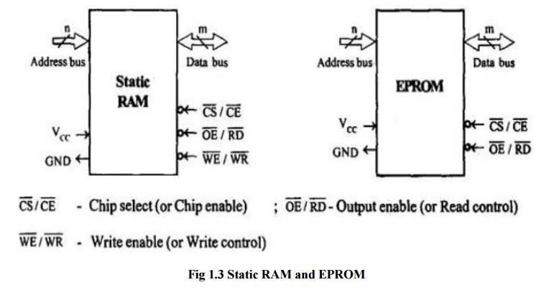
Memory Interfacing
The memory is made up of semiconductor material used to store the programs and data. Three types of memory is,
Process memory
Primary or main memory
Secondary mem

